Slide 1

SD Connector TA type
J.S.T. MFG. CO., LTD

Slide 2
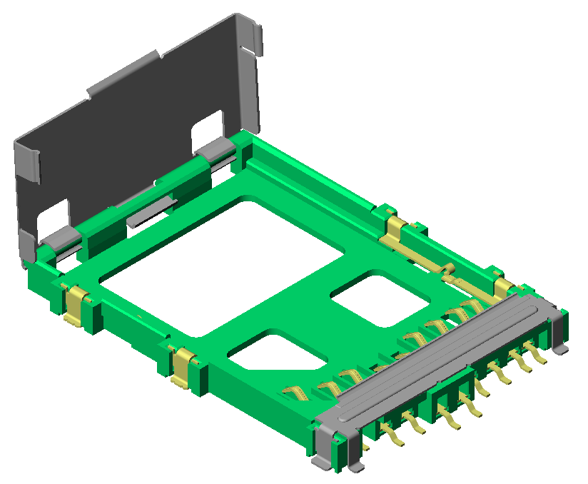
SD Connector TA Type
SD card connector top entry type (SDA standard compliance)
Development Background
Conventional SD or MMC card connector is slide insertion type, which limits the position of the connector to the edge of the PCB. However the top entry type has the advantage of mounting the connector anywhere on the PCB.
Feature
・Sequential mating
・Easy identification of the card label even in the connector
  ・The card is held completely in position by the holder
・The cover can be operated by one hand
・The connector can accommodate all the tolerances
specified in SDA standard, including card warpage
Specifications
Pitch ： ２．５ｍｍ
Circuit ： ９ circuits
Current Rating ： ０．５Ａ
Note ： Write Protect Switch Card Detect Switch

Slide 3
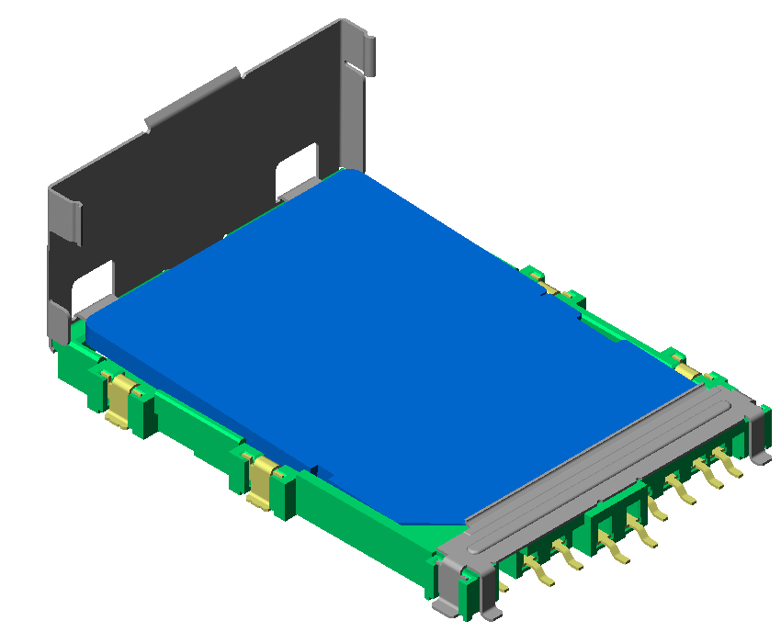
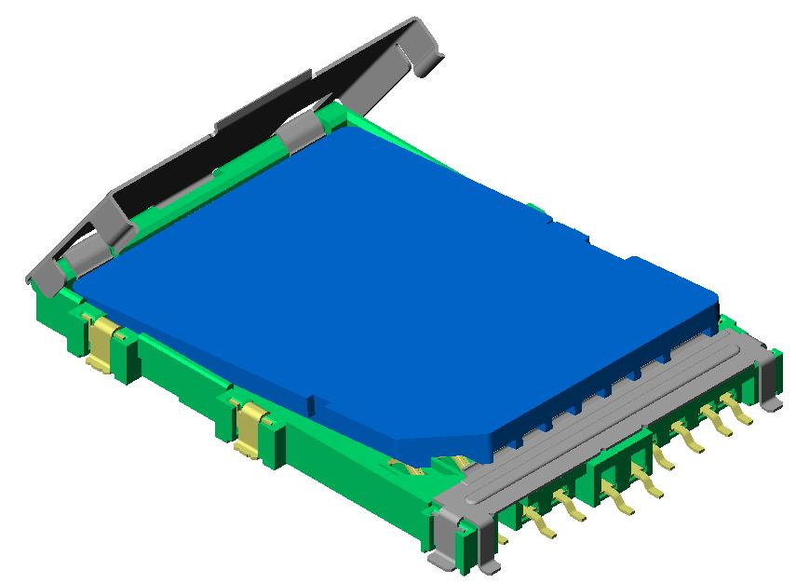
MATING SEQUENCE
MATING SEQUENCE (Power supply to the card needs to be ON at the last timing of insertion, and be OFF at the first timing of withdrawal)
A power supply ON/OFF is triggered by Detect SW.The card guide feature will adjust the oblique insertion to a correct position, and the Detect Switch ON/OFF will operate properly.
Card Guide
Detect Switch
Even if the Detect Switch is triggered ON with an oblique insertion, the card guide will prevent the card from mating.
Card Guide
Detect Switch

Slide 4
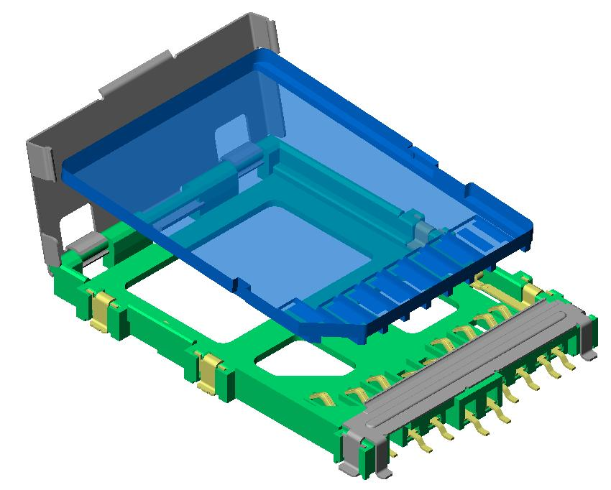
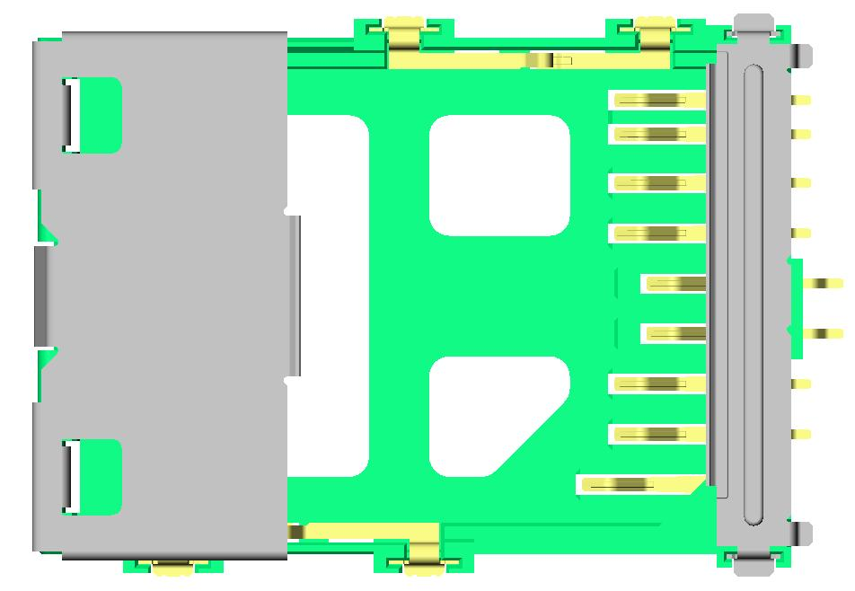
CARD INSERTION AND FREE LOCATION ON PCB
JST’s SD Top entry type: Card insertion from the top
The top insertion of the card allows free location of
the connector on the PCB.
Free location of the connector
PCB
Card insertion from the side The side entry design restricts the placement of the connector only to the edge of the PCB.
Conventional side entry type:
Side entry
connector
SD card
Side entry type
PCB

Slide 5
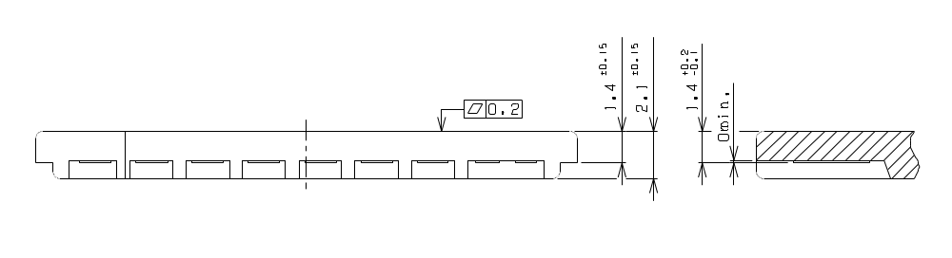
CARD WITHDRAWAL/SD CARD SPECIFICATIONS
Card withdrawal / Insertion
① For easy withdrawal, the card simultaneously pops up when the
holder is opened.
② When the card is inserted and pushed into the connector, the
holder will move down to help closing.
The connector can accommodate all the tolerances specified in SDA standard, including card warpage (MMCA standard compatible).

Slide 6
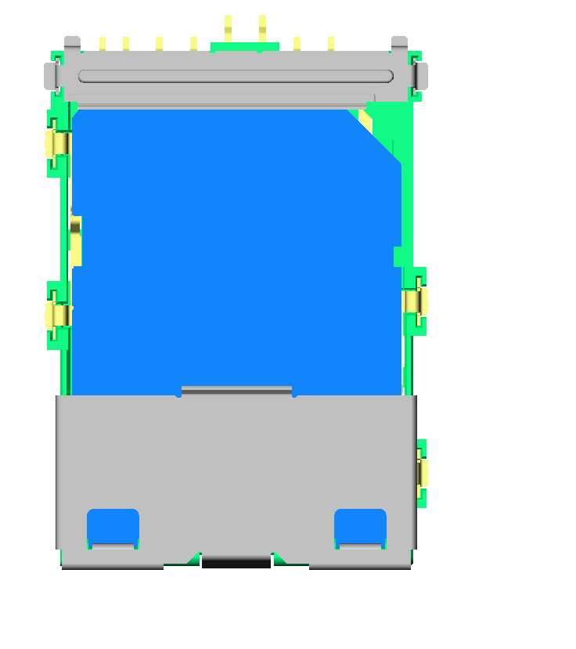
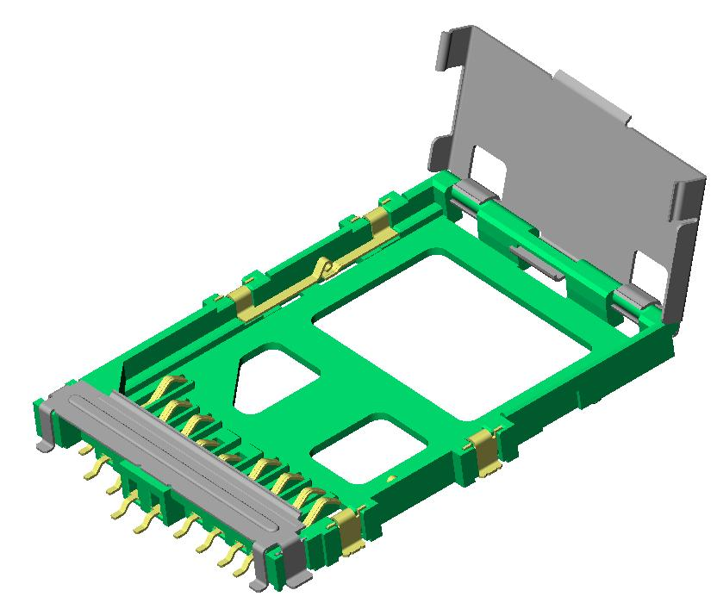
Prevention from misplacement / label identification
Prevention from misplacement
The connector has a polarization key to prevent from misplacement.
Card label identification
The card label can easily be observed while the card is inserted in the connector.
ＳＤ
Reclining corner
ｃａｒｄ

